Slide 1

Project A-z handyman
Developer: Thien Duong
University of Houston-Downtown
Fall 2020

Slide 2
Purpose
To create a website that can connect handymen and potential clients for needed projects
To improve the cost handymen service needed with the advantage of low overhead, robust technology the way Uber improved the cost of riding a cab (or helicopter)
To create more incentives for students to becoming handymen (especially when there’s huge shortage expected in the trade workers market) with self-employment.
To improve the lives of many though affordable services, self-dependence employment through technology and trust.

Slide 3
Tool Proposal
Front-end: VueJS (HTML, CSS, JavaScript)
Architecture: Model-View-Control (MVC)
Back-end: NodeJS, GraphQL, JWT Authentication, Docker, REST API
Database: MongoDB
Version Control: Git, GitHub
Deployment: (AWS || Azure || Google Cloud) for Student

Slide 4
Progress for this week
Drafted project proposal, idea forming
Researched for the tools that fits the purpose of project
Created Development Environment
Sought Resources for Training Purpose (Online Courses for each tool)

Slide 5
Agenda for next week’s Progress
Complete front-end pages and routes architecture
Building Landing Page
Initiate Git Repository for tracking code progress

Slide 6
Progress since last meeting
Added Laborer page
Built laborer’s components
Implement CRUD model for each laborer
Create add new laborer function
Create delete each laborer function
Created delete all laborers function
Created edit laborer function

Slide 7
Project Architecture (for frontend components)
GitHub repos: https://github.com/ducthien97/AZHandyMan
Folder src/:
main.js: Main controller of application
components: Components’ folder consist of all components to be rendered
ActiveUser.vue: render the laborer’ information
UserData: form to create new laborer
EditUser.vue: used to edit user data
App.vue: Vue file to input data to interact with components

Slide 8
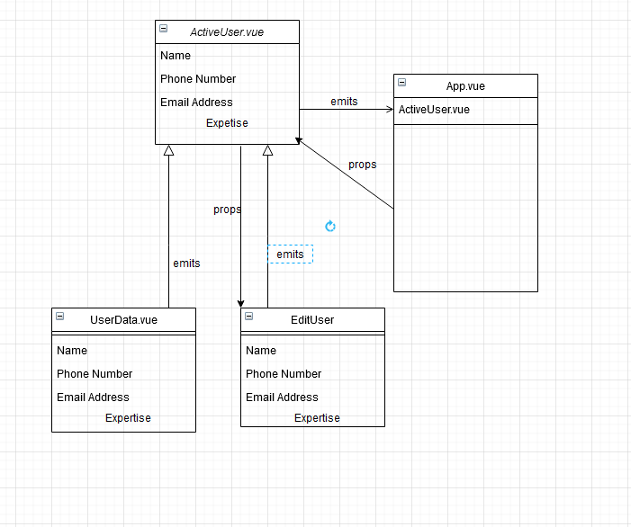
Diagram

Slide 9
Progress to be made before next meeting
Build API for backend
Finish Frontend components and routes
Get start on mongoDB

